Slide 1

Stage 2 Untitled Standards Course Designer: Jordan Rogers
Untitled Standards is a 20 round, 100 point Virginia Count standards exercise. There are 10 USPSA target. The best two hits per target will score. The start signal is audible.
START POSITION Strings 1 & 2: Standing anywhere within either shooting area. Handgun Loaded and holstered. PCC loaded, stock on belt, muzzle pointing down range.
STAGE PROCEDURE String 1: On the audible start signal, engage targets T1-3 OR T8-10 with two rounds each, perform a mandatory reload and engage the remaining array with two rounds each STRONG HAND/SIDE ONLY String 2: On the audible start signal, engage T4 and T7, OR T5 & T6 with two rounds each, perform a mandatory reload and engage the remaining array with two rounds each WEAK HAND/SIDE ONLY. The walls DO NOT extend to infinity, targets may be engaged from below.

Slide 2
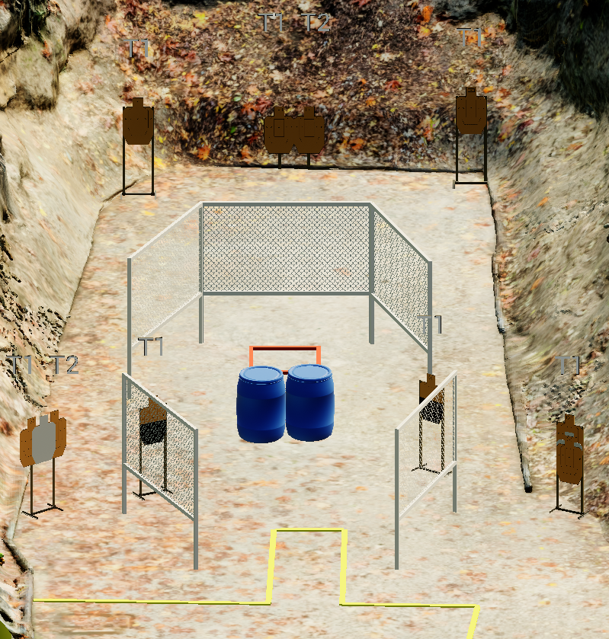
 | Stage 2 Untitled Standards Course Designer: Jordan Rogers

